Slide 1
The Tipping Point Election

Slide 2
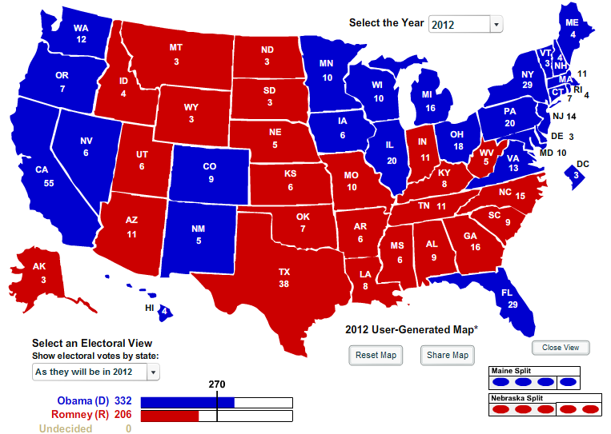
The 2012 Map

Slide 3
Obama’s Margin By State

Slide 4
The Path To 270
272 electoral votes

Slide 5
Direction Of The Country
55%
43%

Slide 6
Obama And The Economy
Is the economy recovering?
NBC News/Wall Street Journal

Slide 7
Total Ad Spending By Group

Slide 8
Ad Spending By State
WI
$55M
NH
$48M
NV
$65M
CO
$85M
IA
$77M
OH
$214M
VA
$165M
FL
$201M

Slide 9
The Electorate

Slide 10
The Electorate

Slide 11
The Obama Coalition

Slide 12
Vote By Race

Slide 13
Coalition Of The Ascendant
19%
21%
24%
26%

Slide 14
The Growing Dem Base

Slide 15
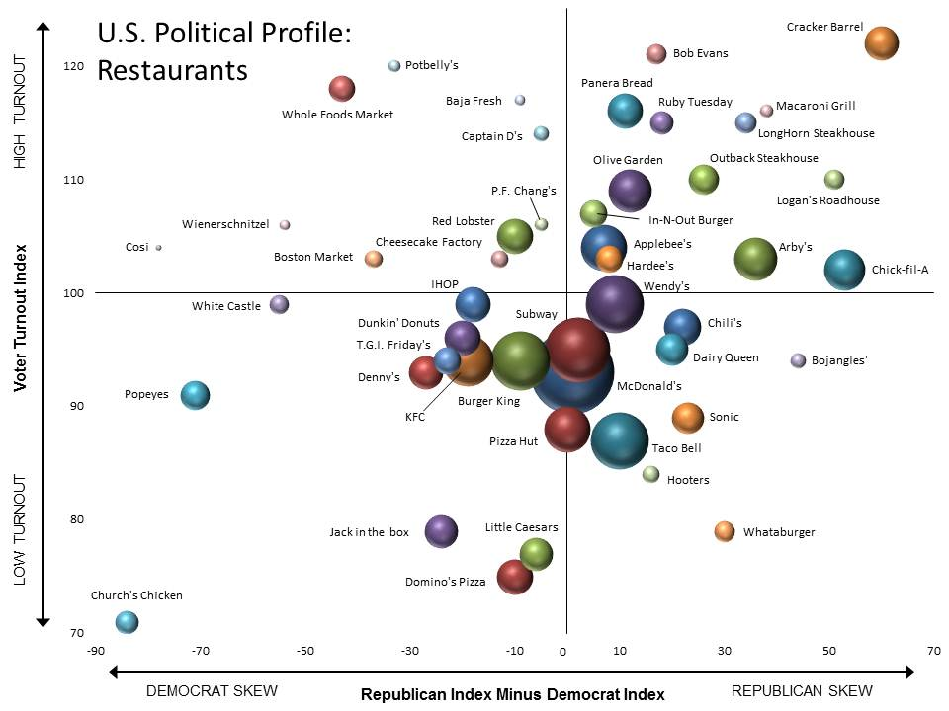
Voting Habits By Food Chain
Dems Eat At:
Popeyes
Whole Foods
White Castle
Repubs Eat At:
Cracker Barrel
Chick-fil-A
Arby’s
Macaroni Grill

Slide 16
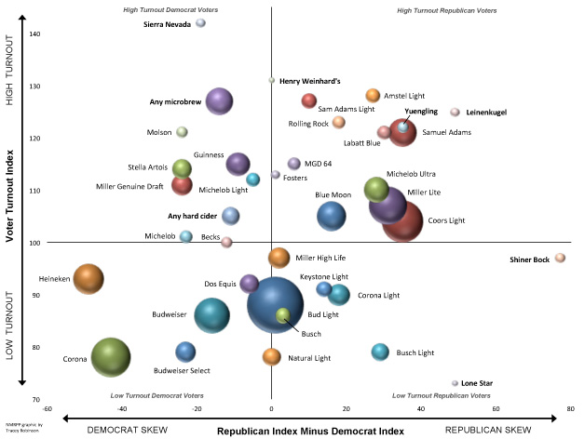
Voting Habits By Beer Preference
Dems drink:
Microbrews
Heineken
Sierra Nevada
Corona
Repubs drink:
Michelob Ultra
Leinenkugel
Coors Light
Miller Light

Slide 17
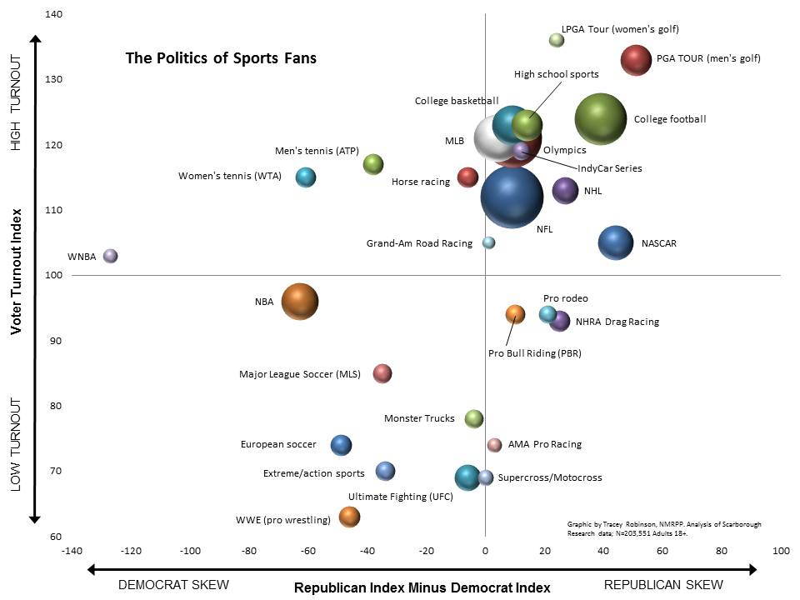
Voting Habits By Favorite Sport
Dems Watch:
NBA/WNBA
Tennis
Soccer
WWE?
Repubs Watch:
PGA/LPGA
College football
NASCAR

Slide 18
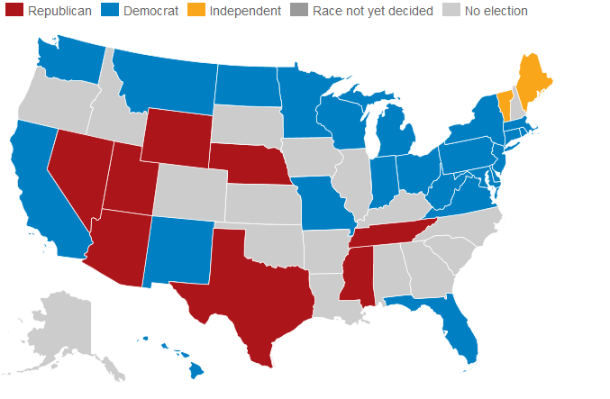
The Senate
112th Congress: 51D, 47R, 2I 113th Congress: 53D, 45R, 2I

Slide 19
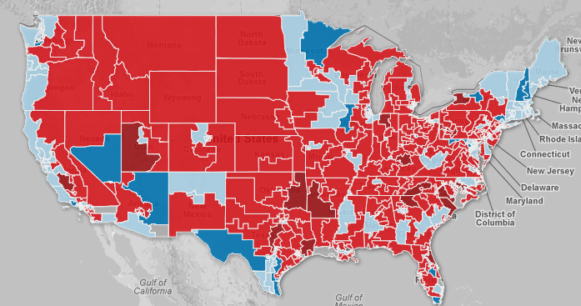
The House
112th Congress: 240R, 190D, 5 vacancies 113th Congress: 234R, 194D, 7 uncalled

Slide 20
The Fiscal Cliff
What’s at stake:
Budget sequester
The debt ceiling
Bush tax cuts
Alternative minimum tax

Slide 21
How Do We Back Away?
The Punt: Let the 113th clean up the mess
The Hail Mary: A grand bargain in a lame duck
The End-Around: Dems gamble on taxes?

