Slide 1
Back to Basics:
Top Accounting, Compliance and Governance Issues Facing the Nonprofit Industry in 2013
January 16, 2013

Slide 2
Course Learning Objective
Update FAR members on the top accounting, compliance, and governance issues facing the nonprofit industry in 2013.
A question and answer session will follow the formal presentation.

Slide 3
Today’s Agenda
Jamie Saylor:
Fiscal Cliff & Other Statutory Changes
DOL Disclosures
2013 Financial Outlook Survey Results
Doug Boedeker:
FASB Activity
Auditing Standards Clarity Project
IRS Exempt Organizations Activity
What’s Brewing in the Media

Slide 4
Fiscal Cliff & Other Statutory Changes

Slide 5
Fiscal Cliff & Other Statutory Changes

Slide 6
Fiscal Cliff & Other Statutory Changes

Slide 7
Fiscal Cliff & Other Statutory Changes

Slide 8
DOL Disclosures

Slide 9
DOL Plan Sponsor & Participant Fee Disclosures
DOL’s goal was to require fuller disclosure rules surrounding fees charged on 401(k)-type retirement plans and provide greater comparability of investment-related information.
Section 404(a)(5) of ERISA requires plan fiduciaries (plan sponsors) to give workers:
    Quarterly statements of plan fees and expenses deducted from their accounts
    Cost and other information about investments under their plan
    Access to supplemental investment information
    These disclosures must use uniform methods to calculate expense and return information

Slide 10
DOL Plan Sponsor & Participant Fee Disclosures
Section 408(b)(2) holds plan sponsors responsible for determining if service arrangements and fees are reasonable.
    Plan sponsors must be informed of the compensation of those paid by a third party (i.e. investment firms or record keepers) to provide services to the plan.
    Payers and recipients must disclose the compensation received and services performed to the plan sponsor.
    DOL enforcement efforts and budget have increased in order to improve compliance. Fiduciaries can be fined a % of the losses arising from prohibited transactions. Plans may also be disqualified resulting in a loss of favorable tax treatment for the plan sponsor and participants.

Slide 11
2013 Financial Outlook Survey Results

Slide 12
Top 3 Financial Priorities for 2013
Rethink revenue model and income generation strategies (47%)
Improve program results & metrics (44%)
Expand fundraising & development (42%)

Slide 13
Top Financial Challenges - Part I
Revenue Stream Consistency
New Non Dues Revenue Streams
Maintaining & Growing Membership
Maintaining Programs with Fewer Resources & Sponsorship & Support
Notes:
Consistency of revenue stream emphasis speaks to the volatility and unpredictable nature of revenue the marketplace has experienced for the last 3-4 years.
Developing Non-Dues revenue streams is consistently cited. Speaks to heavy reliance on narrow revenue base for associations – dues and conference revenue. What are folks seeing as innovative non dues revenue streams.
Maintaining and growing membership is a bit of a new one. Often membership is taken for granted and overlooked. What are associations doing to actively grow membership?
Maintaining programs with fewer resources and support – Nonprofits have made a valiant attempt to squeeze operational costs and make every dollar more effective over the last 3-4 years. There was certainly some fat in the programs and programs that should have been cut. But now we’re leaner but we still need to provide quality programs with less financial and sponsorship support

Slide 14
Top Financial Challenges – Part II
Government Grants
Managing Investment Portfolio & Returns
Better Budgeting and Efficiency
Dealing with the Weak Economy
Expanding Fundraising/Development Efforts
Notes:
Government Grants – This was interesting because the comments surrounding government grants were so diverse – from securing more government grants to increasing the predictability from government grants and contracts to generating alternative revenue sources to offset a reduction in government support. These comments beg the question about how reliable and dependable is government funding to this sector?
Managing Investment Portfolio & Returns – I’m glad someone has an investment portfolio to manage. Probably a c3 with an endowment. What are c3s doing to manage the low rate of return on short term and medium term investments?
Better Budgeting – Still see concern over measuring and evaluating programmatic efficiency and costs; more detailed budgets so as to manage variations and scenario budgeting. How many nonprofits have worst-case vs. best-case budgeting scenarios for revenue and expenses?
Weak Economy – This is fairly generic. What is the main impact on an association of a weak economy? Membership?

Slide 15
Growth Expectations
Nearly 60% of participants expect slow revenue growth (1-9%) in 2013
Almost all organizations planned to maintain (59.5%) or grow (39.2%) their staff next year
Notes:
According to the 2012 3Q Business Roundtable survey, CEOs of for profit companies are decidedly pessimistic about near-term sales, capital spending and hiring. The lowest composite score since the third quarter of 2009.
4th Quarter 2012 Business Roundtable survey, “CEOs anticipate continued slow overall economic growth for the next six months and have slightly lower expectations for sales and capital expenditures,” said Jim McNerney, Chairman of Business Roundtable and Chairman, President and CEO of The Boeing Company. “The continued softness in quarterly sentiment reflects deep uncertainty about the future overall economic climate, realities of a slow-growing economy and frustration over Washington’s inability to resolve looming ‘fiscal cliff’ issues.”
In addition to fiscal policy issues, 35 percent of the CEOs reported that regulatory costs were of highest concern in the next six months, followed by labor and health care costs. This contrasts with the fourth quarter of 2011, when material costs were the CEOs’ top concern. The CEO survey is now in its 11th year.

Slide 16
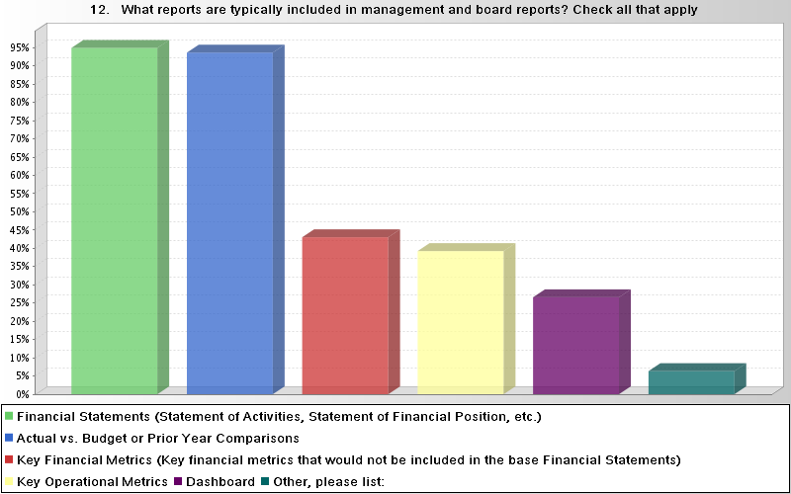
Reporting
Notes:
Financial Statements (Statement of Financial Activities and Financial Position) – 95%
Actual vs. Budget or Prior Year Comparisons – 94%
Key Financial Metrics not included in Financial Statements – 43%
Key Operational Metrics – 39%
Dashboard – 27%
Other – 6% - Included Estimates of Revenue, Expenses, and Cash Flow for the year, Treasurer’s Report outlining Key revenue and expense stats, cash flow summary, membership information, Investment portfolio and 3 year projections.

Slide 17
Reporting
77% of reports are distributed via email
55% are made available via hardcopy packets
Less than 22% of organizations present financial and operational metrics to management and the board through a Dashboard

Slide 18
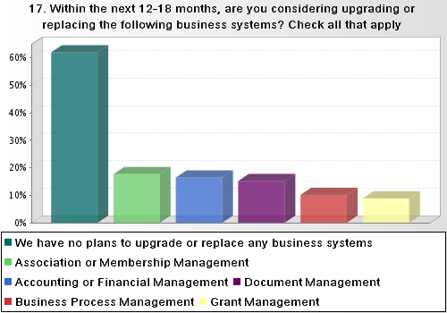
Systems

Slide 19
FASB Activity

Slide 20
Watching the FASB
Lease Project (yes, we still care!)
Donated Affiliated Personnel Costs
Donated Securities – cash flow reporting
NFP Financial Reporting Project

Slide 21
FASB - Lease Project
Exposure draft scheduled for first half, 2013.
“Right of Use” model has been affirmed.
Service contracts and intangibles are excluded.
Are you consuming more than an insignificant portion of the leased asset?
  “YES” = “Interest & Amortization” Approach
  “NO” = “Straight-Line” Approach

Slide 22
FASB - Lease Project (continued)
Is your tenant/customer consuming more than an insignificant portion of the asset you have leased to them?
  “YES” = “Receivable & Residual” Approach
  “NO” = “Straight-Line” Approach
In general, calculating the lease term and future minimum lease payments will be much simpler from the initial proposal.

Slide 23
FASB – Donated Securities on the SCF
Issue was discussed by the FASB’s EITF.
If donated security is directed for immediate sale, then operating activity.
If donor restricted for long-term purposes, then financing activity.
Otherwise, investing activity.
Effective for years beginning after June 15, 2013.

Slide 24
FASB - Contributed Services from an Affiliate
Still in exposure draft.
Would require a recipient NFP to recognize in its standalone financial statements all personnel services received from an affiliate that directly benefit the recipient NFP.
Services would be measured at the cost recognized by the affiliate for the personnel providing those services.
Final standard anticipated during first half of 2013.

Slide 25
FASB – Not-for-Profit Financial Reporting: Financial Statements
Improve the current net asset classification scheme.
Improve statements of activities and cash flows to more clearly communicate liquidity and financial performance.
Review existing NFP-specific disclosure requirements to improve relevance and understandability.
The Not-for-Profit Advisory Committee (NAC) is playing a key role.

Slide 26
The Auditing Standards Clarity Project

Slide 27
Audit Clarity Project – SAS 122
Changes to Auditing Standards
58 AU sections 47 new AU-C sections
  3 withdrawn
  37 redrafted to corresponding SAS
  7 combined into 1 new SAS
  11 combined/split into 9 SASs
  AU section numbers changed to converge with ISA numbering
Effective for audits of periods ending on or after 12/15/2012

Slide 28
Audit Clarity Project – Noteworthy Items…
The term “OCBOA” has been replaced with “Special Purpose Framework”.
Auditors must now specifically perform procedures to detect noncompliance with laws and regulations. (Used to be called “illegal acts”.)
  Used to say, “No assurance” regarding illegal acts.
  Now, we reference “Inherent limitations of an audit.”
Increased procedures on opening balance testing for initial audit engagements.

Slide 29
Audit Clarity Project – Noteworthy Items…
Auditor must now communicate (orally or in writing) control deficiencies that merit management attention.
  Aimed at items less severe than a significant deficiency or a material weakness.
Auditor’s communications regarding significant deficiencies or material weaknesses must now also discuss the potential effects of the deficiency/weakness.

Slide 30
Audit Clarity Project – Noteworthy Items…
The term “unqualified opinion” is now being replaced with the term “unmodified opinion”.
Wording of the auditor’s report is changing to further explain management’s responsibilities, the auditor’s responsibilities, and what an audit is.
Section headers (heading titles) are now required to be used within the auditor’s report.

Slide 31
IRS Exempt Organization Areas of Interest

Slide 32
IRS Exempt Organization Focus Areas
Scrutiny of “Self-Declarers”
  Relates to 501(c)(4), (c)(5), and (c)(6) entities.
  Review of organizations and information questionnaires.
990-T Filers
  Analyzing Form 990-T with interest in entities reporting significant gross UBI but with no tax due.

Slide 33
IRS Exempt Organization Focus Areas
Governance
  Using data from the Form 990 to look at connection between governance practices and tax compliance.
Group Exemption Rulings
  Issuing questionnaires to select groups to learn about parent/central organization oversight.

Slide 34
IRS Exempt Organization Focus Areas
Foreign Bank Accounts
  Do organizations have oversight of these accounts? Are funds used for exempt purposes?
“National Research Project” (Employment Tax Reporting)
  Employee or Independent Contractor?

Slide 35
What’s Brewing in the Media

Slide 36
Bloomberg’s Association Expose’
“Tax-Exempt Firm Gets $600 Million Profit Flying First Class”
  David Evans; Bloomberg Markets Magazine; November 14, 2012.
A must-read article for association executives!
Questions the U.S. practice of allowing associations to self-declare exempt status.
Should royalties be tax-exempt?
Executive compensation always draws scrutiny!

Slide 37
Governance Questions Continue
“Leon Black Investing Dartmouth Money Stirs Ethics Debate”
  Gillian Wee; Bloomberg Markets Magazine; January 7, 2013.
Basic conflict of interest issue.
Can safeguards overcome perception?
But, what if the conflict is profitable?

Slide 38
Charities Are Still Subject to Scrutiny
“Charities Deceive Donors Unaware Money Goes to a Telemarketer” and “Telemarketers Lying for Charities Prompts Call for U.S. Probe”
  David Evans; Bloomberg Markets Magazine; September 12, 2012 and December 4, 2012, respectively.
Questions tactics used by outsourced fundraisers.
Be cautious how you present your fundraising percentage to prospective donors.

Slide 39
Questions & Answers
Doug Boedeker, CPA, CMA, Tate & Tryon
  dboedeker@tatetryon.com
  202-419-5106
Jamie Saylor, CPA, Veris Consulting
  jsaylor@verisconsulting.com
  703-654-1446

